Slide 1




Scores and Rankings
Chuan-Ming Liu
Computer Science & Information Engineering
National Taipei University of Technology
Taiwan

Slide 2
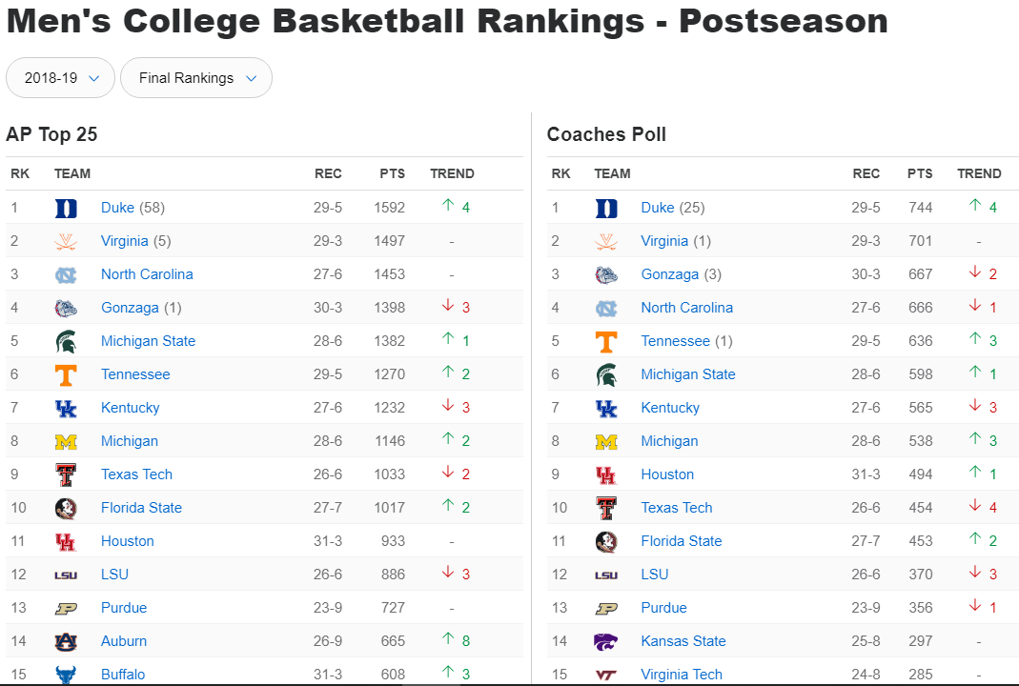

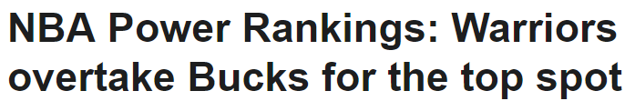


Scores and Rankings
Scoring functions are measures that reduce multi-dimensional data to a single value, to highlight some particular property.
Rankings order items, usually by sorting scores.

Slide 3
Example – Grades
Course grades get assigned by scoring functions.
Observe that grading systems have:
Degrees of arbitrariness: each teacher differs.
Lack of validation data: there is no right grade.
General robustness: students tend to get similar grades in all their classes anyway.
Calling scores statistics lends them more dignity.

Slide 4

The Body-Mass Index (BMI)
BMI is a score designed to capture whether your weight is under control:
Mass is in kg and height in meters
Underweight: below 18.5
Normal: 18.5 to 25
Overweight: 25 to 30
Obese: over 30

Slide 5
Pro Basketball and US Football
BMI is easy to interpret, and correlates with body fat.
Mass should scale with the square (or cube) of height.

Slide 6
Players by Position

Slide 7
Gold Standards and Proxies
Scores are functions that map the features of each entity to a numerical value of merit.
Gold standards are labels or answers we trust to be correct, reflecting the scoring goal.
Proxies are available quantities correlated with what we want to measure.
Your GPA or SAT/GRE is a proxy for how you should do in the class.

Slide 8
Scoring vs. Regression
The critical issue in designing scoring functions is that there is no gold standard/right answer.
Machine learning techniques like linear regression can learn a scoring function from features if you had training data, which generally you don’t.
Google’s ranking algorithms train on click data.

Slide 9
Scoring vs. Machine Learning
When you have a gold standard, you can train a regression function to accurately predict things.
When all you have are proxies, all you can do is evaluate your scoring function.
“Weapons of Math Destruction” happen when you confuse proxies for gold standards: e.g. student test scores for teaching quality.

Slide 10
Scores vs. Rankings
Which is more interpretable depends on:
Will the numbers be presented in isolation?
Stony Brook ranks 111th of 351 teams RPI=39.18
What is the distribution of scores?
How much better is #1 than #2?
Small changes in score can cause big rank diffs
Do you care about the middle or extremes?
Rankings are good at highlighting the very best and very worst entities, but less so the differences near the median.

Slide 11
Good Scoring Functions
Easily computable
Easily understandable
Monotonic interpretation of variables
Produces satisfying results on outliers
Uses systematically normalized variable
Breaks ties in meaningful ways

Slide 12
Normalization and Z-scores
It is critical to normalize different variables to make their range/distribution comparable.
Z-scores are computed:
Z-scores of height measured in inches is the same as height measured in miles.
Your biggest analysis sins will come in using unnormalized variables for analysis!

Slide 13
Z-score Examples
Z-scores have mean 0 and sigma=1.
Thus Z-scores of different variables are of comparable magnitude.
The sign identifies if it is above/below the mean.

Slide 14
Advanced Ranking Techniques
Linear combinations of normalized values generally yield reasonable scores, but other techniques include:
Elo rankings
Merging rank orderings
Directed graph orderings
PageRank

Slide 15
Binary Comparisons
Rankings are often formed by analyzing series of binary comparisons:
Team A beats team B
Expert votes for A instead of B
Student choses university A over B
Vote counts fail to pick the best when different teams face different levels of competition.

Slide 16
Elo Rankings
ELO Rating System is a common ranking approach used in sports or video games.
It is originally designed for ranking professional chess players.
It is an ideal solution for someone who wants to add a ranking system to their own projects

Slide 17
Elo Rankings
After starting equally ranked, scores are then adjusted to reflect the surprise of each match.
Steps include:
Every player has an “Elo Rating”, which is a point total representing their relative skill level.
New players are assigned an initial rating.
When matches are completed between two players, their ELO points are compared:
Winner will take a certain number of points from the loser.
Players with higher ELOs are expected to win, so winning will net them few points. Conversely, when an underdog wins, they take many points from the winner.

Slide 18
Elo Rankings
Performance in an ELO system is not measured absolutely; rather, it is inferred from wins, losses, and draws against other players.
Formula:
old rank
maximum possible swing in any one match
new rank
the actual score (usually(0,1)) for A
the expected score from the previous r(A) and r(B)

Slide 19
Actual Score, S
The actual score of the match is usually
0 ≤ x ≤ 1, for example:
a win counts as 1
a tie counts as 0.5
a loss counts as 0
This is non-standard.

Slide 20
Expected Match Score
If P_{(A>B)} estimates the probability that A beats B, then:
If the ranking system is meaningful, this probability should be a function of the (skill) difference between the scores r(A) and r(B).
It uses a Cumulative Distribution Function for Score Estimation.

Slide 21
Logistic CDF
Arpad Elo’s original algorithm utilized the Normal CDF, the World Chess Federation uses the Logistic implementation.
Logistic CDF
sometimes μ=0
scale: preselected standard deviation

Slide 22
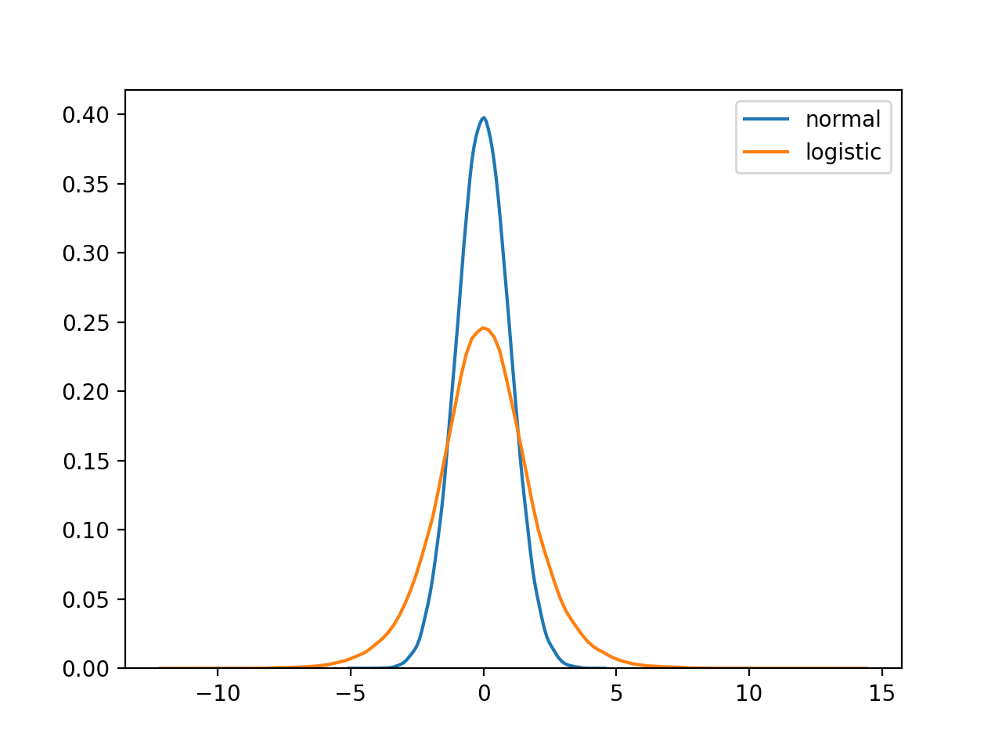
Normal vs Logistic Distributions
The default Logistic distribution has thicker tails, meaning that “upsets” are assumed to be more likely (which helps account for inconsistency in player ability).

Slide 23
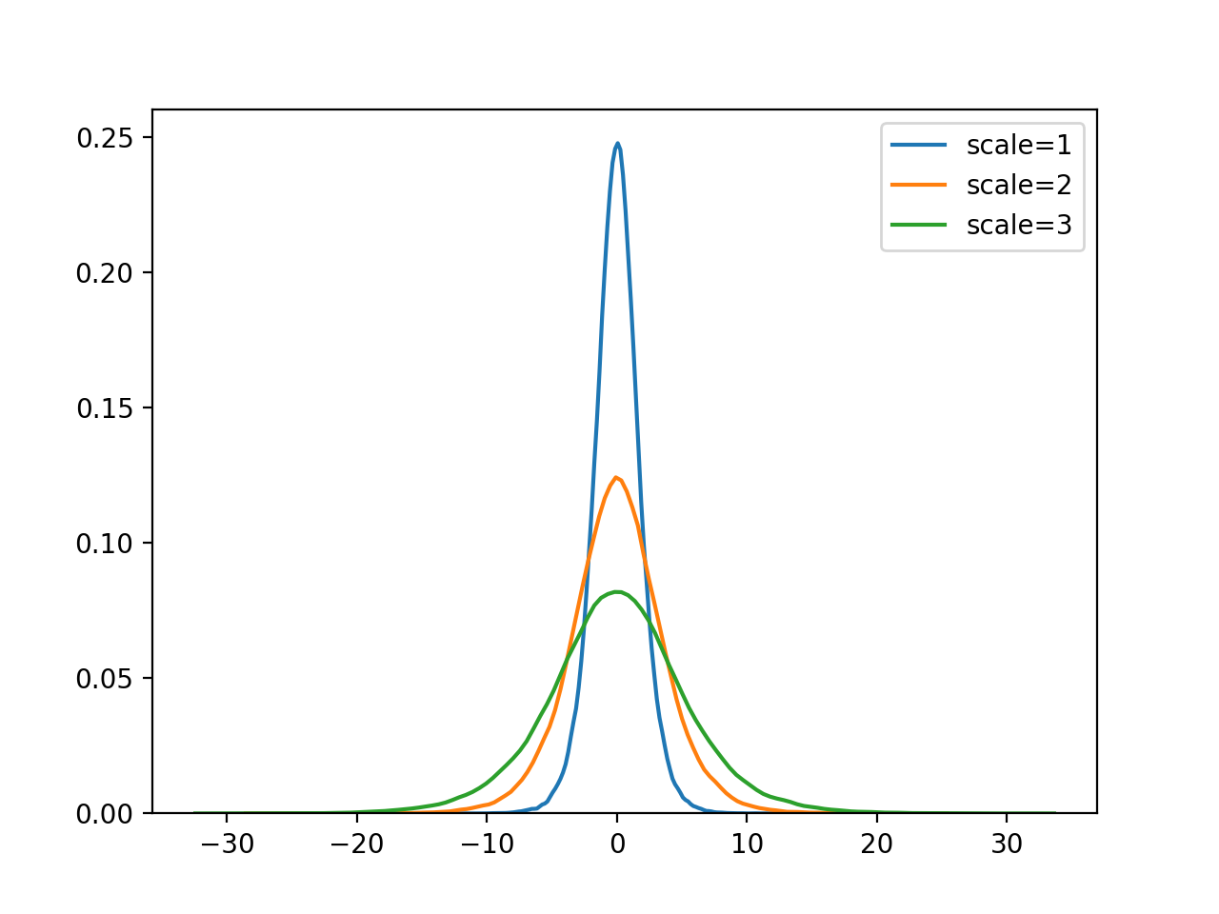
Scale Affects
The scale affects the “width” of the distribution.
Larger scales will stretch the distribution, increasing the ELOs of the best players, while decreasing the ELOs of the worst players
Making some substitutions to the scale allow us to better reason about its relationship with player skill.

Slide 24
Logistic Function

Slide 25
Setting Scale
Setting scale , then
Furthermore,
After selecting a value of n, with given scores r(A) and r(B), the score estimation result will be returned.

Slide 26
Scale Estimation
# When players are equal strength (n = 100)
A = 1000; B = 1000
x = (1000 - 1000) = 0
exponent = -(x/100) = 0
expected = 1/(1+10^exponent) = 0.5
# ∴ Score estimation for player A = 50%
# When player A is 10x better (n = 100)
A = 1100; B = 1000
x = (1100 - 1000) = 100
exponent = -(100/100) = -1
expected = 1/(1+10^exponent) = 0.9090...
# ∴ Score estimation for player A = 90.90%

Slide 27
Scale Estimation
# When player A is 40 ELO points better (n = 100)
A = 1234; B = 1184
# Calculation for player A
x = (1234 - 1194) = 40
exponent = -(40/100) = -0.4
expected = 1/(1+10^exponent) = 0.7152
# ∴ Score estimation for player A = 71.52%
# Calculation for player B
x2 = (1194- 1234) = -60
exponent2 = -(-60/100) = 0.6
expected2 = 1/(1+10^exponent) = 0.2847
# ∴ Score estimation for player B = 28.47%
# Notice how it equals (1-estimation(A))

Slide 28
K-factor
The K-factor determines the “sensitivity” of how wins and losses impact the ELO.
If K is large, then unexpected wins (or losses) can have a huge impact on a player’s ELO, and cause the rankings to be volatile.
Small K factors can result in stagnant rankings, and would make it very difficult for players to gain ELO
K-factor should be appropriate for the current value of n (for score estimation).

Slide 29
World Chess Federation
The official World Chess Federation ratings actually use a tiered K-factor system with n=400.
K=40 for new players until they play 30 games
K=20 for players with > 30 games and never had an ELO > 2400
K=10 for players with > 30 games and have had an ELO > 2400

Slide 30
Soccer/Football Rankings
Soccer/Football rankings give matches of high importance a higher K-value (also with n = 400):
K=60 for World Cup Finals
K=40 for World Cup Qualifiers
K=30 for other tournaments
K=20 for friendly matches

Slide 31
Recommendation for K-factors
If few matches will be played (such as American Football, with ~16 games), then the rankings should be more volatile.
Higher K factors [relative to n] would be better
If many matches will be played (such as Baseball, with ~162 games), then the rankings should be less volatile.
Lower K factors [relative to n] would be better

Slide 32
Example
A series of tennis matches with players Amy, Brad, Cindy, and Dirk.
First, we need to make 3 decisions.
Scoring estimation, n=50
A higher K-factor [relative to n], K=5
Initial ELO ranking 100
Winner | Loser | ELO Change | Amy | Brad | Cindy | Dirk
- | - | - | 100 | 100 | 100 | 100

Slide 33
Elo Chess Ranking Example

Slide 34
Merging Rankings/Votes
Consider determining the winner of an multiparty election where each voter ranks the candidates in order of preference.
1. Stony Brook 2. MIT 3. Illinois 4. ….
Equivalently, consider merging rankings independently drawn on different features.

Slide 35
Order of Preference
One interprets the sorted order of some feature as defining a permutation P_{i} on the items of interest.
The problem becomes to find the consensus permutation P, which somehow best reflects all of the component permutations P₁,…, P_{k}.
requires defining a distance function to measure the similarity between two permutations.

Slide 36
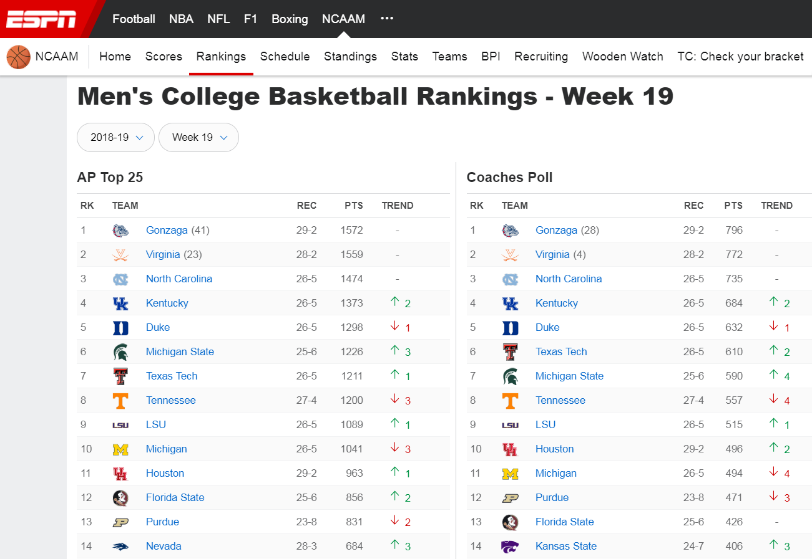
Men's College Basketball Rankings

Slide 37
Borda’s Method
Borda's method creates a consensus ranking from multiple other rankings by using a simple scoring system.
For example, by assigning an increasing score per position, the resulting point total ranks the items:
Four voters, each ranking five items.

Slide 38
Graphs
A graph is a pair (V, E), where
V is a set of nodes, called vertices
E is a collection of pairs of vertices, called edges
Vertices and edges are positions and store elements
Example:
A vertex represents an airport and stores the three-letter airport code
An edge represents a flight route between two airports and stores the mileage of the route

Slide 39
Applications
Electronic circuits
Printed circuit board
Integrated circuit
Transportation networks
Highway network
Flight network
Computer networks
Local area network
Internet
Web
Databases
Entity-relationship diagram

Slide 40
Applications
Electronic circuits
Printed circuit board
Integrated circuit
Transportation networks
Highway network
Flight network
Computer networks
Local area network
Internet
Web
Databases
Entity-relationship diagram

Slide 41
Edge Types
Directed edge
ordered pair of vertices (u,v)
first vertex u is the origin
second vertex v is the destination
Undirected edge
unordered pair of vertices (u,v)
flight
AA 1206
ORD
PVD
849
miles
ORD
PVD

Slide 42
Directed and Undirected Graphs
Directed graphs
all the edges are directed
Undirected graphs
all the edges are undirected

Slide 43
Terminology
Let G=(V, E) be a graph and (u, v) an edge
u and v are adjacent
edge (u, v) is incident on vertices u and v
If G is a directed graph and (u, v) be an edge
vertex u is adjacent to v and v is adjacent from u
edge (u, v) is incident to u and v
edge (u, v) is an outgoing edge of u
edge (u, v) is an incoming edge of v

Slide 44
Graphs
1
Edges incident to 2 are
(1, 2), (2, 1), (2, 3)
2
3

Slide 45
Degree of a Vertex
The degree of a vertex, deg(v), is the the number of edges incident v.
If G is a digraph and v is a vertex of G
in-degree of a vertex v, indeg(v), is the number of incoming edges of v.
out-degree of a vertex v, outdeg(v), is the number of outgoing edges of v.
a
V
b
h
j
U
d
X
Z
c
e
i
W
g
f
Y

Slide 46
Paths
A path P from vertex u to vertex v in a graph G is a sequence of vertices u, i₁, i₂, …, i_{k}, v, such that (u, i₁), (i₁, i₂), …, (i_{k}, v) are edges in E(G).
The length of a path is the number of edges on it
A simple path is a path in which all vertices are distinct

Slide 47
Cycles
A cycle is a path with at least one edge such that in which its start and end vertices are the same
A simple cycle is a cycle in which each vertex is distinct except possibly the first and last one.

Slide 48
Directed Graphs
In a directed graph (digraph),
for two vertices u and v, <u, v> and <v, u> represent two different direction edges.
we may use a directed edge to present the order between two entities:
a directed edge <u, v> denotes that for each vote u ranks ahead of v.
G:
a
c
g
d
e
f
b

Slide 49
DAGs and Topological Ordering
A directed acyclic graph (DAG) is a digraph that has no directed cycles
A topological ordering of a digraph is a numbering v₁ , …, v_{n} of the vertices such that for every edge (v_{i} , v_{j}), we have i < j
v₄
v₅
D
E
D
E
v₂
B
B
v₃
C
v₁
C
Topological ordering of G
A
DAG G
A

Slide 50
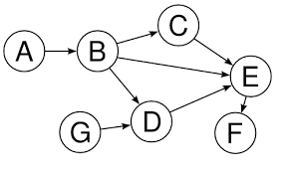
Directed Graph Orderings
If there are no inconsistencies, we get a directed acyclic graph (DAG).
Topologically sorting this DAG gives a reasonable order, like ABCGDEF or GABCDEF.
It is exceedingly unlikely that a real set of features or voters will all happen to be mutually consistent.

Slide 51
Ranking General Digraphs
For general directed graphs, we seek the order minimizing the number of ``wrong way’’ edges.
Cutting the minimum number of edges to leave a DAG is NP-complete.
maximum acyclic subgraph problem
reasonable heuristics start by sorting by the difference between in/out degree.

Slide 52
Arrow's Impossibility Theorem
No election system for aggregating permutations of preferences satisfies the following desirable and innocent-looking properties:
Completeness
Transitivity
Consistency
Generality
Independency
No best ranking system exists ?!

